Slide 1
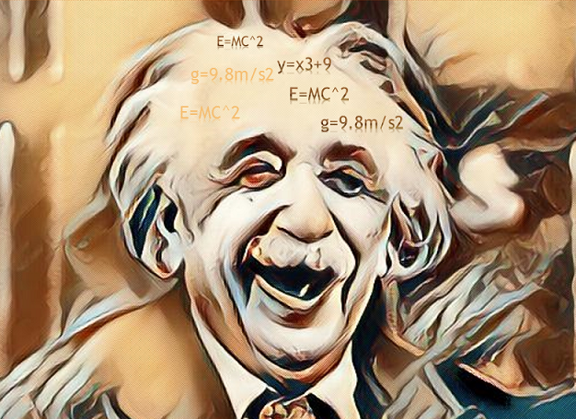
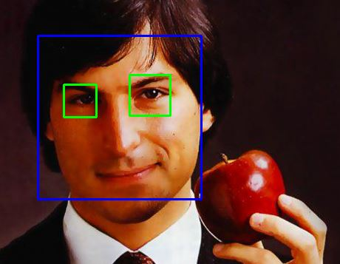
Facial Recognition App
RegisterFace.py
Step -1: Register & Capture Face
&
Train Model
One Time Only
TrainFace.py
RecognizeFace.py
Step -2: Recognize the face
App is ready

Slide 2
Facial Recognition App
RegisterFace.py
Step -1: Register & Capture Face
&
Train Model
One Time Only
TrainFace.py
RecognizeFace.py
Step -2: Recognize the face
App is ready

